Slide 1
BASS & V
Notes:
Hi Everyone ,
We are BASS & V

Slide 2
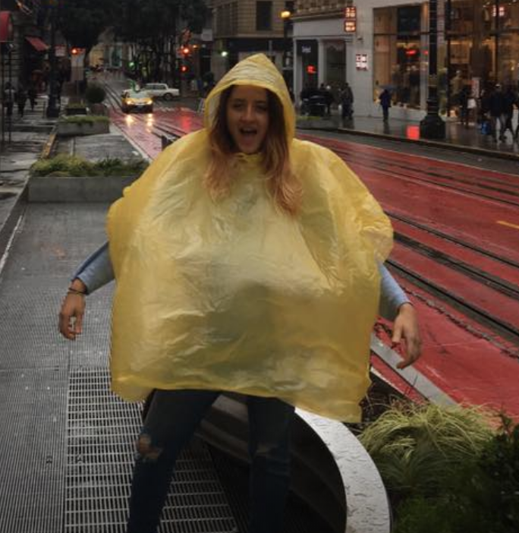
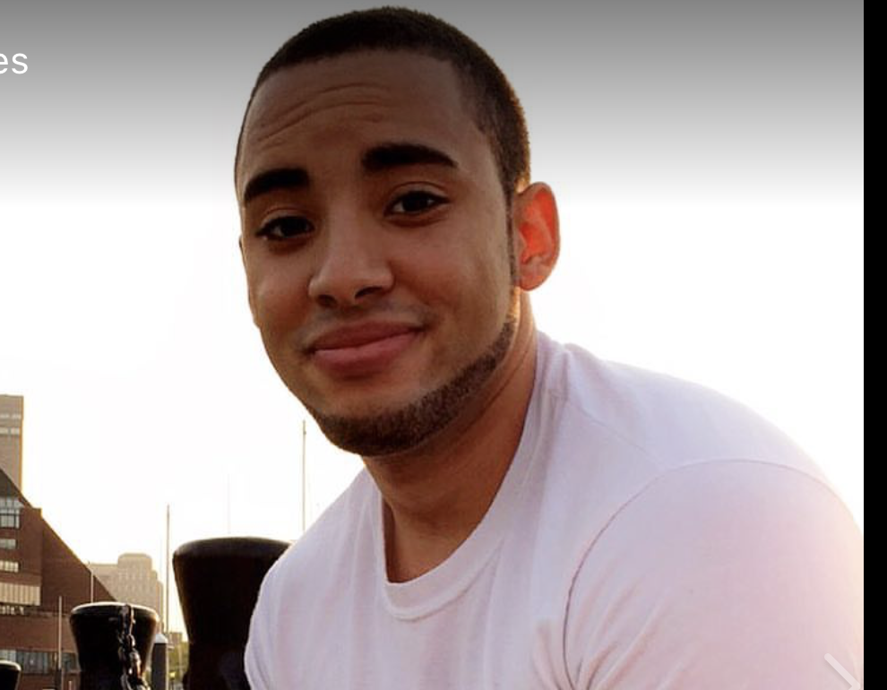
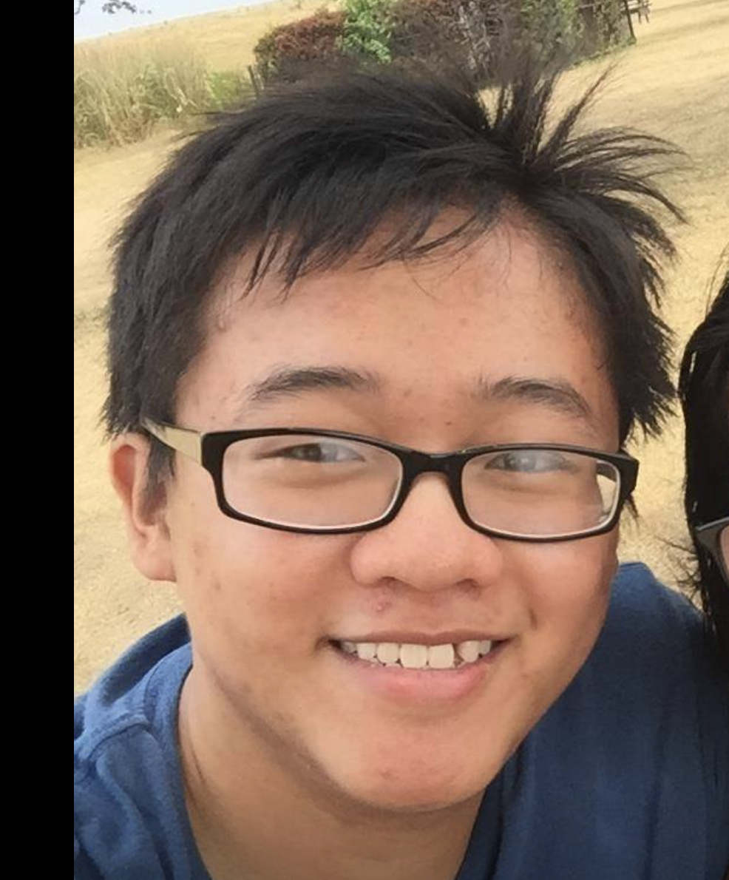
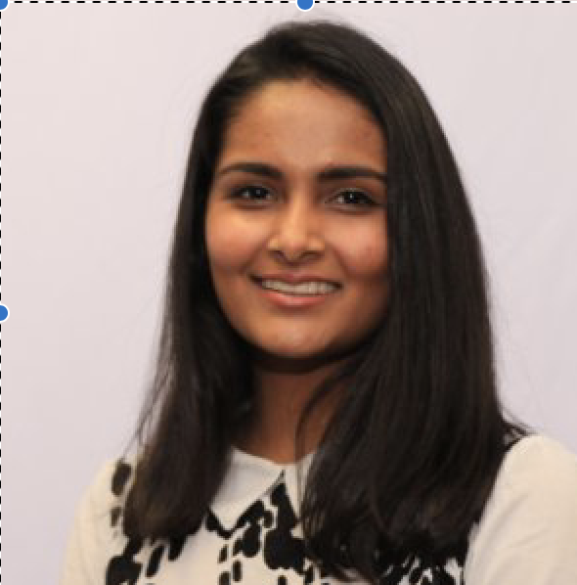
BASS & V
Vincent Tran
Shivangi Singh
Salem Couja
Ani Gevorgyan
Brendon Delgado
Notes:
My name is Salem, and my team members

Slide 3
Notes:
Please enjoy a short introduction video to our product. Then we’ll get into the details in a moment.

Slide 4

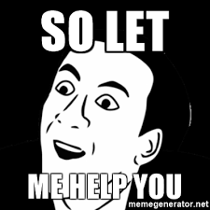
TA &Co.
Show how you solve the problem you identified.
What will be different when the problem is solved (by you)?
Notes:
So our application is called TA&Co. As it is designed for communication between Professors and Teaching Assistants

Slide 5
Our Application is specifically designed for Teaching Assistants and Professors, but it can be customized for any organization for group communication and task assignments.

Slide 6



Framework:
FrontEnd
BackEnd
BootStrap
HTML
CSS
JavaScript
Django
Python
Notes:
It is built using HTML/CSS, JavaScript and BootStrap in the FrontEnd and Python and Django in the backend.

Slide 7
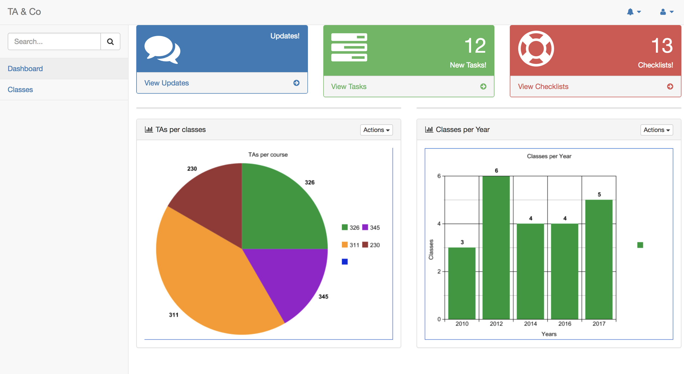
Notes:
As we know each professor can teach many classes and each TA can be part of more than one class. Our Application supports two kinds of Users: TAs and professors each with a different view. Here we can see the professor’s view dashboard with the general information about the classes. On the left side we have a sidebar with the classes. As you can see this is a pretty simple UI to use for everyone.

Slide 8
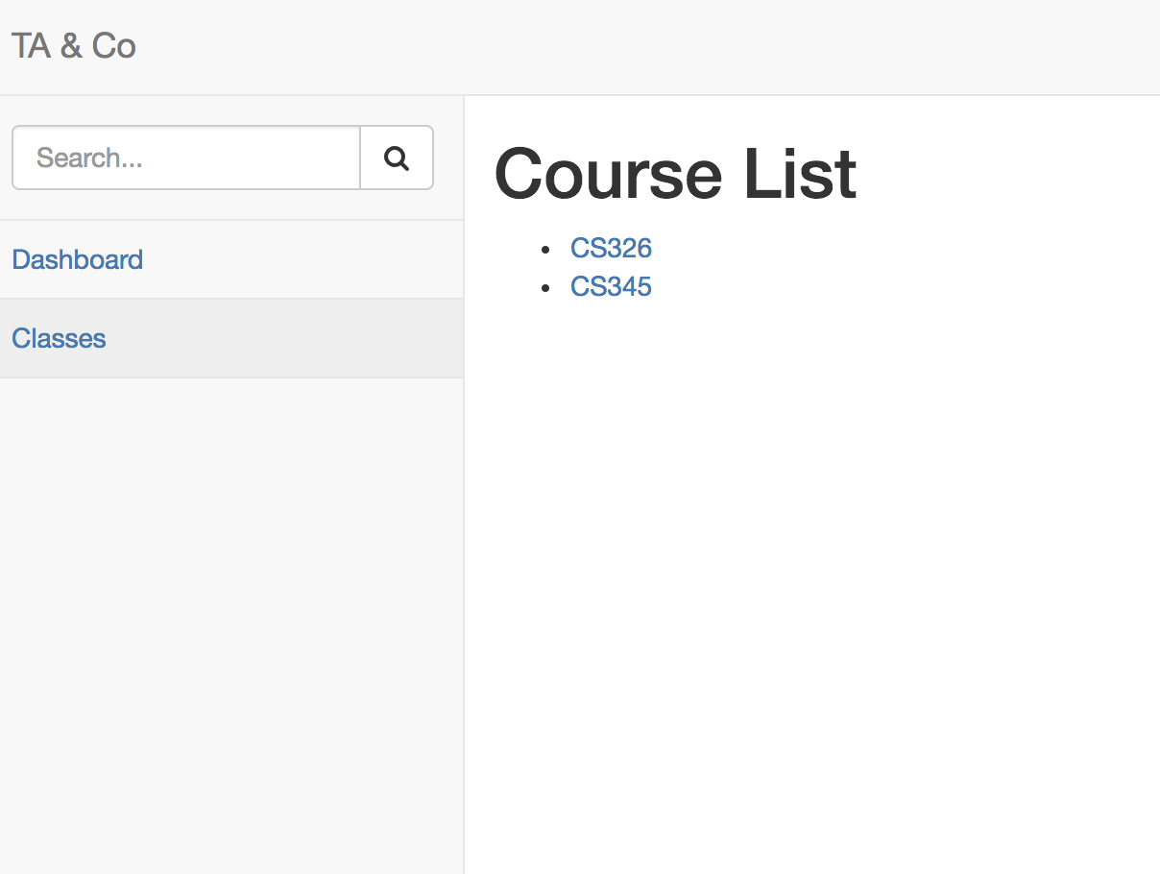
Notes:
Displays Courses the current user is a part of.

Slide 9
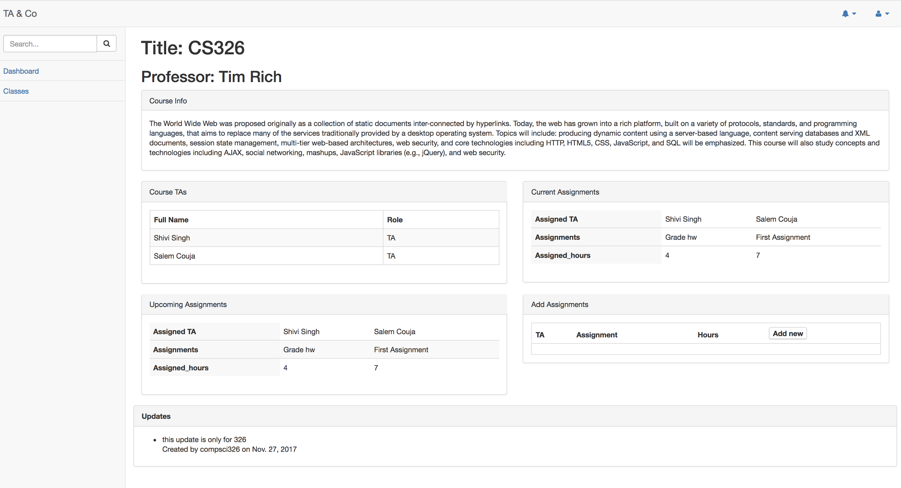
Add/ Delete Assignments on the go
Notes:
When we click on each course we get this view of the course detail. Here we can see the professor’s name that is teaching this course with a short description of the class, course TAs and the assignments for each TA with the assigned hours as well as the upcoming assignments. Each professor will be able to add a task for TAs and any time something is changes it will appear as an update at the bottom of the page.

Slide 10
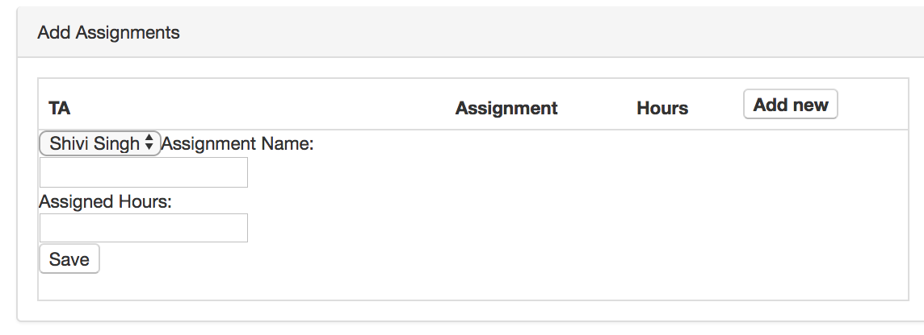
Notes:
Professors are able to add assignments for specific TA’s and the required hours for each assignment. New assignments are saved to the database by course ID. Newly added assignments show up for TA’s in their upcoming assignments but TA’s cannot add new assignments, they can only edit the number of hours worked.

Slide 11
Easy | Difficulties
Django, HTML/CSS | Team Meetups/Team Communication.
Setting up the Framework | Had to modify our models several times.
 | Getting the forms to connect.

Slide 12
Future Work
Add Profiles for TA’s and Professors.
Make the charts Dynamic
Make a UI so that the Professors can add TA’s on their own.
Have more features like Message Communication as, as of now we can only make changes to the assignments and that show up in the updates.

Slide 13


